Slide 1
Welcome
A Move Toward Positive Change Future Start Today Not Tomorrow We Believe In Excellence

Slide 2
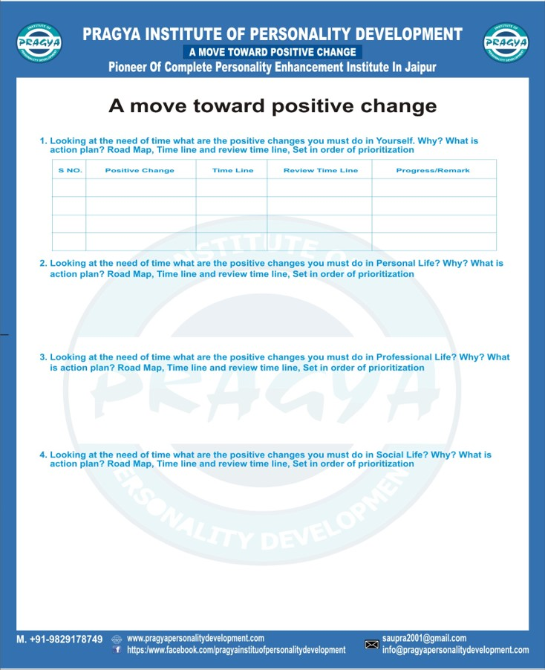
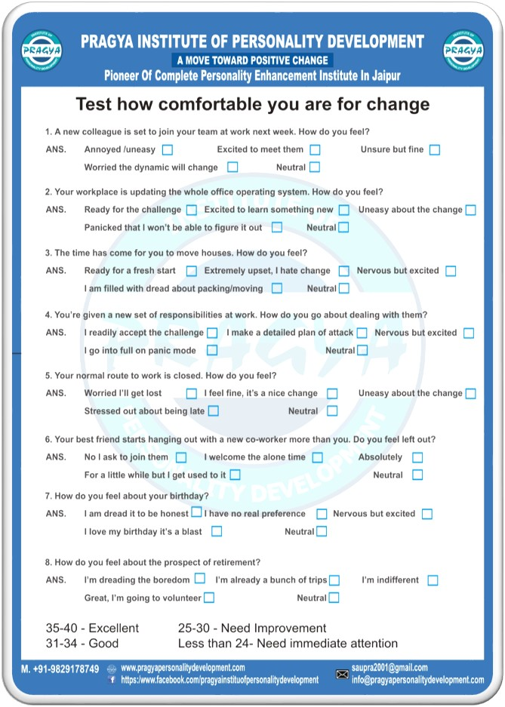
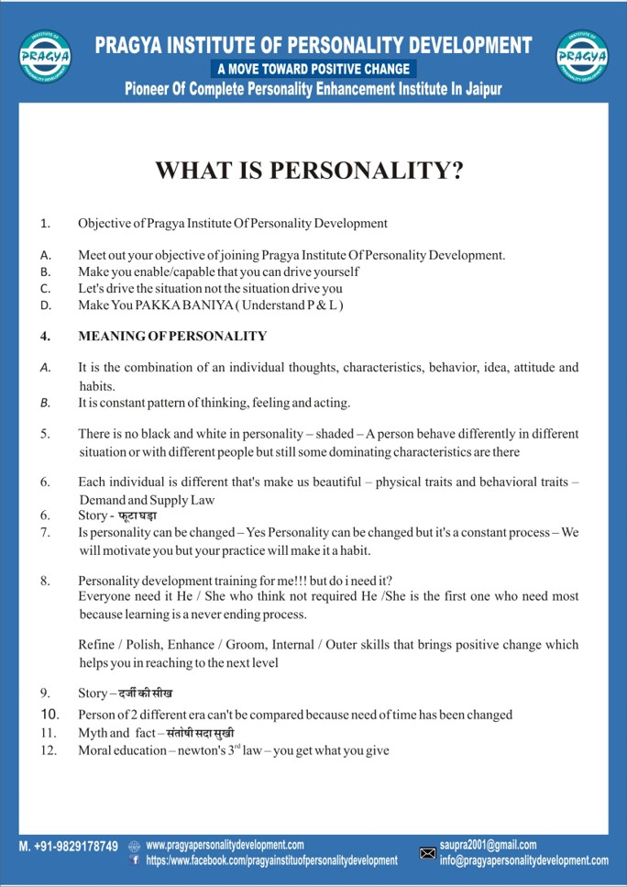
About Us, Why We Are Best?
Pioneer Of Complete Personality Enhancement And Life Skill Management Institute In Rajasthan
We Are Redefining Meaning Of Personality Development As Per The Need Of VUCA World
We Value Your Time And Money – We Will Change Your Perspective To Look At Life – Life Changing Experience Guaranteed
Faculty With World Class Training Ability
Small Batches, Not Crowd – We Believe In Quality
Case Study Based Learning, Psychological Test You Can Know Better About Yourself, Worksheets, Take Home Message Sheet
Activity Based Learning Environment And 100% Practical Approach
Friendly Environment To Learn World Class Skill – Certificate At The End Of The Course

Slide 3
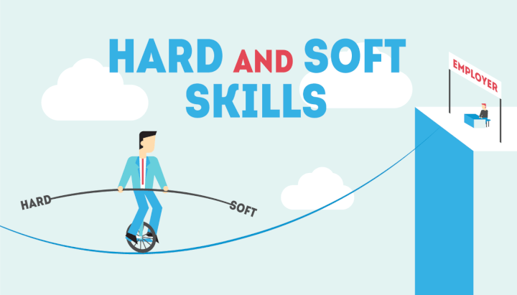
Why Soft Skills & Life Skills?
Life Is Not About How Good You Are, It’s All About How Good You Want To Be
Improve Personal, Professional And Social Effectiveness
Mandatory For Survival And Growth In 21st Century – Meet New Challenges And Opportunities
Only Way To Overcome Unemployment And Underemployment
Understand How To Win And How To Live – Don’t Die Before You Die
Bridge Between Class Room And Outside World
Achieving Success Without Soft Skills And Life Skills Is Just Day Dreaming

Slide 4
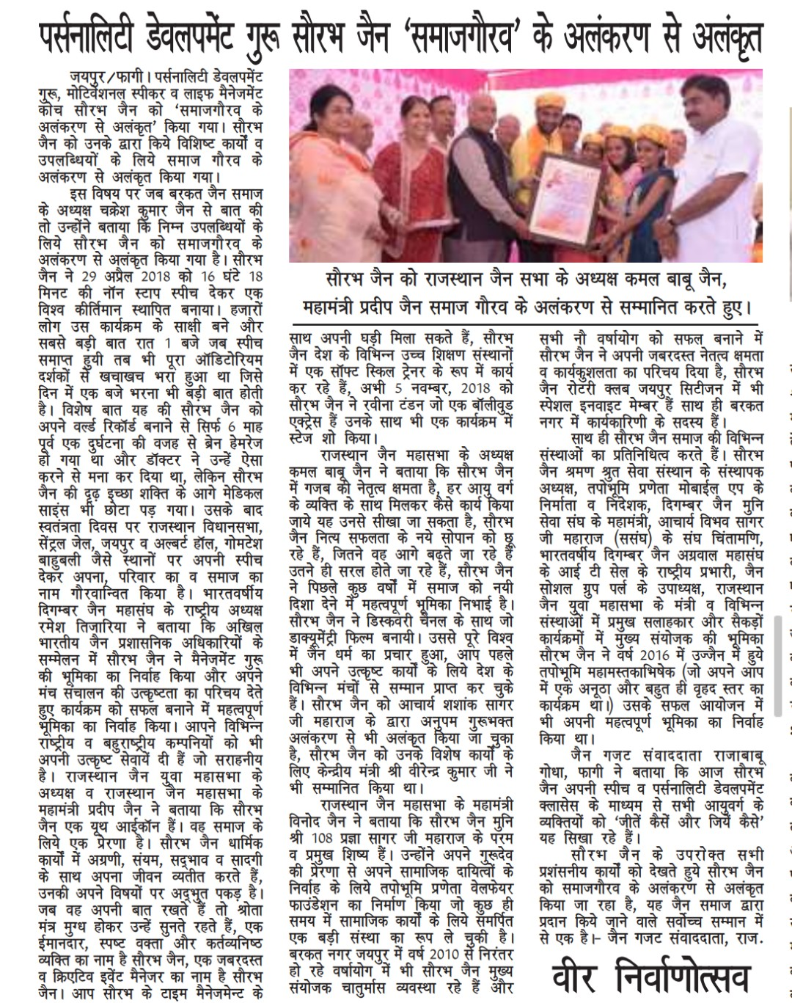
Our Director/ Trainer : Saurabh Jain
15+ Years Of Experience
World Record Holder For Longest Nonstop Speech On Personality Development
Soft Skill Trainer And Life Management Coach In Prestigious Institutes Like ICAI, ICSI, ICMAI
Given Speech In Rajasthan Legislative Assembly, Central Jail- Jaipur, Albert Hall and Many Other Prominent Places Of Country
Worked With Discovery Channel
Taken 1000+ Interviews And Prepared 1000+ Candidates For Interview
Awarded As Personality Development Guru And Innovator Of Practical Motivation
Trainer For Many National And Multinational Companies

Slide 7
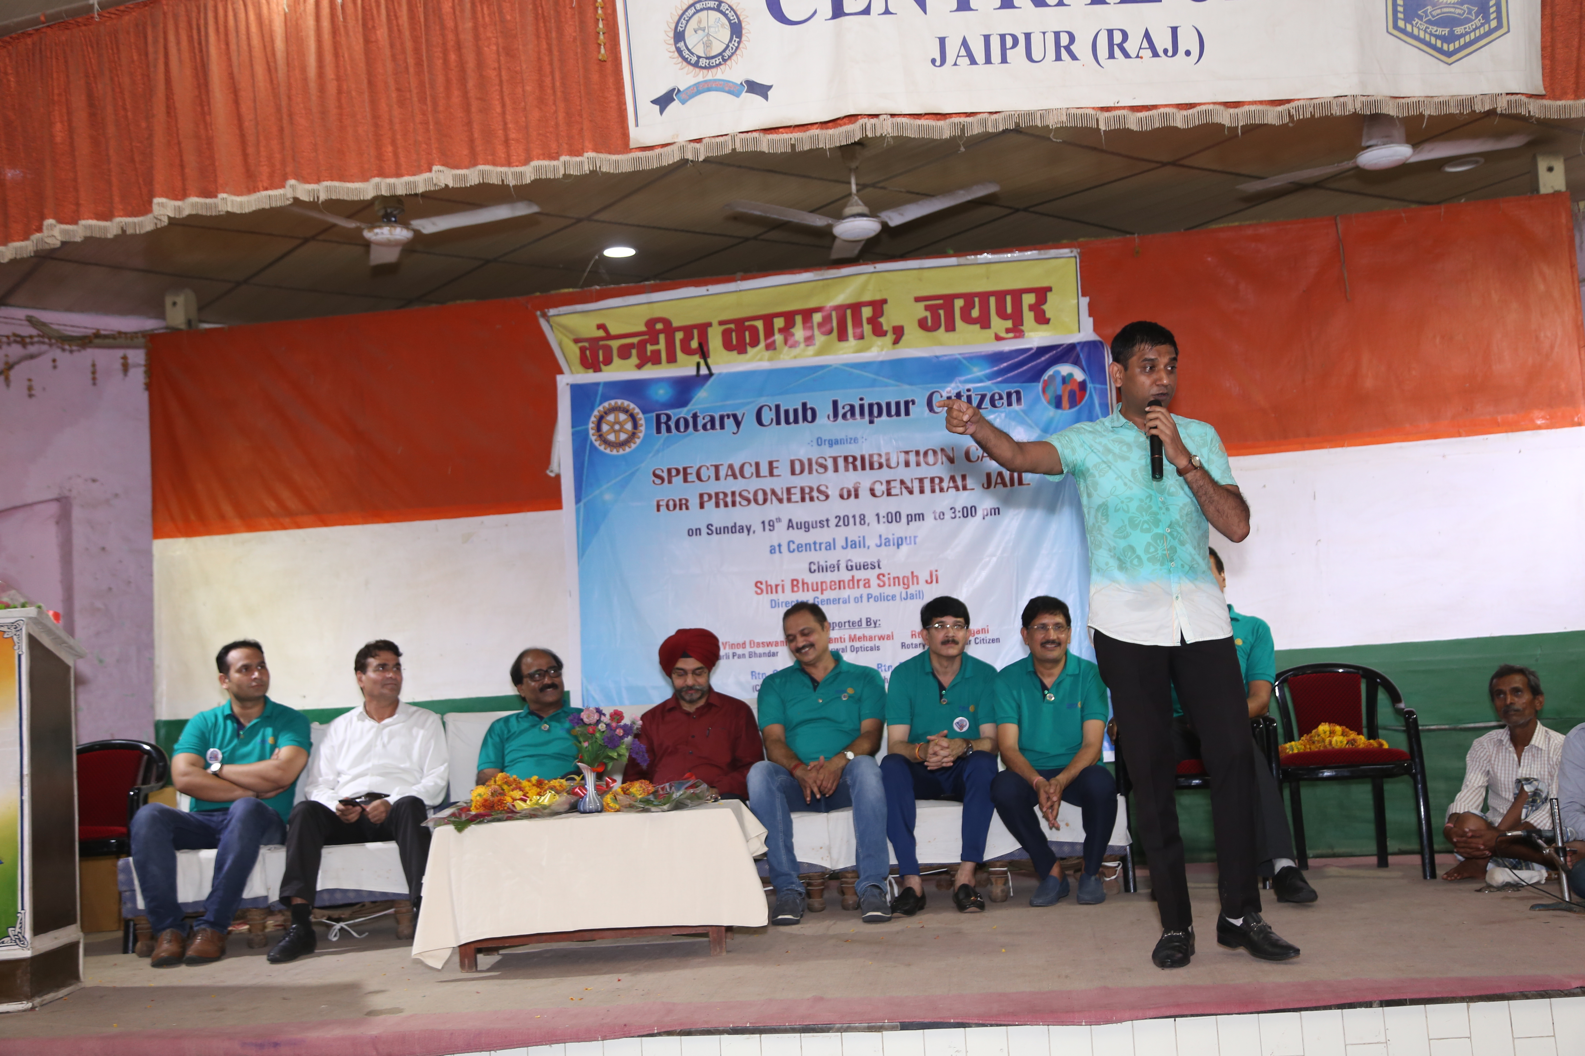
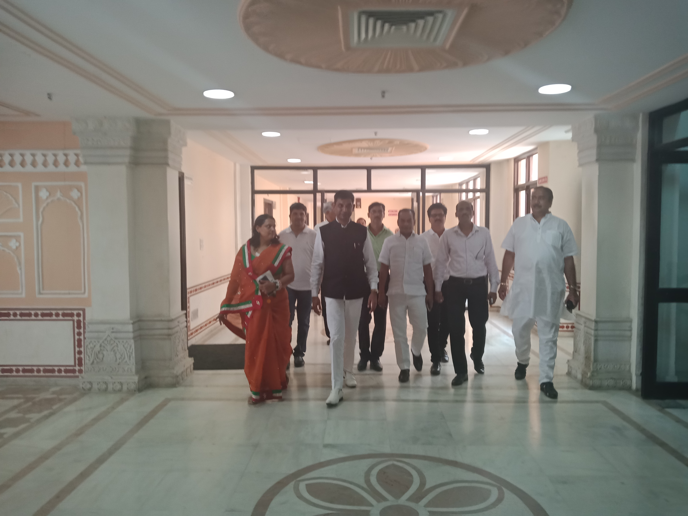

Slide 8
Courses And Fee Structure
Course | Details | Duration | Fee
Beginner Course Of Personality Development And Life Skill Management | Page No. 15 To 48 | 20 Days 2 Hours/ Day | Rs. 5,000/- Cheque/ Cash/ Online
Intermediate Course Of Personality Development And Life Management | Page No. 15 To 77 | 35 Days 2 Hours/ Day | Rs. 7,000/- Cheque/ Cash/ Online
Advanced Course Of Personality Development And Life Management | Page No. 15 To 116 | 55 Days 2 Hours/ Day | Rs. 10,000/- Cheque/ Cash/ Online

Slide 9
Courses And Fee Structure
Course | Details | Duration | Fee
Sales Training For Sales Executive |  | 10 Days 2 Hours/ Day | Rs. 5,000/- Cheque/ Cash/ Online
Employability Skills - Job Interview Preparation |  | 15 Days 2 Hours/ Day | Rs. 6,000/- Cheque/ Cash/ Online
Communication Skills |  | 15 Days 2 Hours/ Day | Rs. 5,000/- Cheque/ Cash/ Online

Slide 10
Courses And Fee Structure
Course | Details | Duration | Fee
Team Management/ Leadership Skills |  | 15 Days 2 Hours/ Day | Rs. 7,000/- Cheque/ Cash/ Online
Interview Preparation For Medical Representative |  | 17 Days 2 Hours/ Day | Rs. 7,000/- Cheque/ Cash/ Online
Relationship Building |  | 15 Days 2 Hours/ Day | Rs. 5,000/- Cheque/ Cash/ Online

Slide 11
Courses And Fee Structure
Course | Details | Duration | Fee
Training Programme For Start Up |  | 10 Days 2 Hours/ Day | Rs. 5,000/- Cheque/ Cash/ Online
Scientific Career Counselling |  | 10 Days 2 Hours/ Day | Rs. 5,000/- Cheque/ Cash/ Online
Train The Trainer | Soft Copy Of Complete Study Material Will Be Provided | 120 Days 2 Hours/ Day | Rs. 100,000/- Cheque/ Cash/ Online

Slide 12
Courses And Fee Structure
Course | Details | Duration | Fee
Telephonic/ Online Consultancy/ Consultancy Clinic |  | Max. 30 Minutes | Rs. 500/- Cheque/ Cash/ Online
One Day Seminar | On Various Topics | 1 : 30 Hour | Rs. 500/- Cheque/ Cash/ Online
Guest Faculty/ Motivational Speaker/ Trainer/ Business Coach | Subject To Requirement Of Clients | Subject To Requirement Of Clients | Subject To Requirement Of Clients

Slide 13
An Overview : Beginner Course Of Personality Development And Life Skill Management
Follow Path Of Excellence With Confidence | How To Set Goals? We Help You In Designing Your Life | How To Take Calculated Risk? Power Of Universe
Be Competent As Per Need Of 21st Century | Pathway Of Success, Choose The Best And Do The Best But How? | Journey Toward Perfection, Do It And Do It Now
Be An Impressive and Influential Personality | How To Convert Passion Into Profession? | Patience Is The Key, Let’s Understand Facts
Be Dynamic But How? | Be Result Oriented But How? | Take Your Communication Skills To The Next Level
Life Begins At The End Of Comfort Zone | Develop Strong Will Power But How? | Perception Management
Power Of Belief System, Programming Of Brain | Be An Effective Planner And Fast In Execution With Excellence | Be An Effective Communicator, Art Of Negotiation
Think Positive And Act Positive But How? | Plan Your Execution and Execute Your Plan But How? | Communication Is The Key To Success, Dressing Sense
Know Your Potential | Be Fast Mover, Key Factor In 21st Century | Group Discussion, Debate, Presentation
Problem Solving Skills | Key Learnings For Happiness | Improve Public Speaking
For More Details Go Through Our Brochure
Page No. 15 To 47

Slide 14
An Overview : Intermediate Course Of Personality Development And Life Skill Management
English Speaking – Practical Way To Do It | How To Manage Failure? | Honesty Is Wisdom
How To Give Negative Feedback Positively? – Relationship Building | How To Overcome Fear Of Failure? | How To Grain Trust And Become Loyal
How To Receive Feedback? And How To Say Yes And No? | Learner Is The Way to Become Good Earner | Know How To Earn Respect?
Observe, Absorb And Express Key Skill For A Winner | How To Become Genius? | How To Become Cool And Smart Personality?
Develop Powerful Habits Of Winners, Important Tips On Daily Habits | How To Control Anger? How To Manage Ignorance? | Be Creative And Overcome Fear But How?
How To Become Disciplined? | Know How To Manage Expectation And Insult? | Important Tips To Overcome Fear
Unless You Stay Focus, Forget About Victory | Quotient Management – EQ/ IQ/ LQ | How To Increase Concentration And Memory
How To Make Your Life Great? | How To Control Ego And Manage Self Esteem? | Aim High, Achieve More
Develop Etiquette But How? | Power Of Magical Words – Will Change Your Life | Difference Between Love And Attachment
For More Details Go Through Our Complete Brochure
Page No. 15 To 77 (Includes Beginner Also)

Slide 15
An Overview : Advanced Course Of Personality Development And Life Skill Management
Private Job/ Government Job/ Entrepreneurship - Why Or Why Not – Guidelines For Startup | Power Of Inspiration & Motivation, Stop Giving Excuses | How TO Quit Addictions?
Develop And Improve Critical Thinking, Develop Strong And Rapid Decision Making | Best Success and Life Skill Mantra | How to Live Happy? Achieve What You Want
How To Become Celebrity? | Time Management Is Life Management, How To Manage Time Effectively | Formation Of Unbeatable Team, How To Build A Strong And Champion Team?
How To Conduct Successful Meetings & Data Security? Email Writing Skills | Tips And Techniques To Avoid And Manage Conflict | Prepare for Interview, Tips and Techniques Ensure Success
Life Is Nothing But Sales And Marketing | Love Is Key, Open Many Locks | Know Hidden Facts About Interview Preparation
Improve Yourself As Per The Need Of 21st Century, Understand Needs And Ways | Managing & Building Relationship | Complete Guide to Become a Remarkable Leader
Talent/ Attitude, Skill/ Score, Education/ Experience | Life Is Art, Science And Commerce Of Living | How To Become Incredible Leader?
Develop Positive Attitude, Difference Between Attitude And Arrogance | How To Become Ethically Rich And Mentally Tough? | Be Handsome But How?
Live Your Life, Don’t Have Regret When Dying | Practical Tips To Live Stress-Free Life? | How To Write Your Own Destiny? Law Of Karma
For More Details Go Through Complete Brochure
Page No. 15 To 116 (Includes Beginner + Intermediate Also)

Slide 16
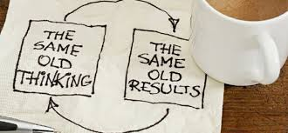
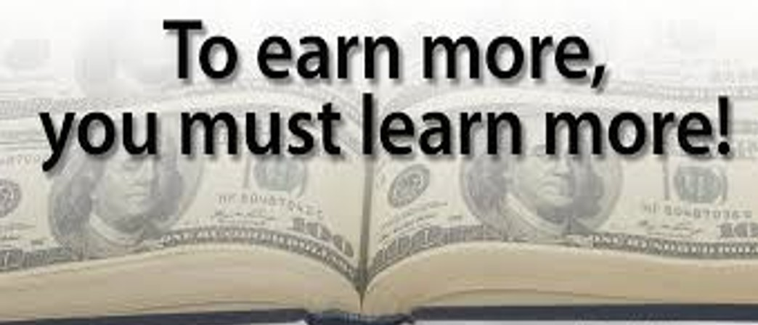
Who Can Join Us :
Anyone Age Above 14 Years
Students Of Any Stream
In Private Job
In Government Job
Self Employed/ Businessman
Political Leaders
Home Maker / Working Women
Retired Person
Belongs To Any Professional Or Social Field

Slide 17
Choose Us N Believe In Your Choice

Slide 18
The Future Starts Today – Take Necessary Steps : Follow Path Of Excellence With Confidence
You Are Already A Billionaire, Want To Know How?
Success Through Excellence Is Real Way To Achieve
Questioning Is Science, Be Curious
How And How Much To Use Google
To Earn More You Need To Learn More, How To Keep Yourself Updated
Know Your Own Importance And Don’t Compare Yourself With Others

Slide 19
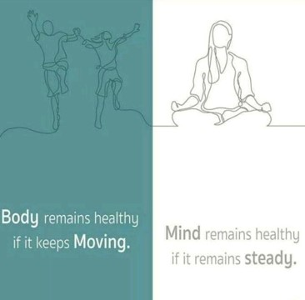
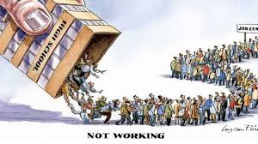
Education Is Not The Learning Of The Facts, But The Training Of The Mind To Think : Be Competent As Per The Need Of 21st Century
Yes, Indian Education System Has Lot Of Flaws, Being A Part Of This You Can Do Miracle
Journey From Student To Professional
Huge Gap In Class Room And Outside World, Want To Know How To Bridge That Gap?
Best Investment, Invest On Yourself
One Day Or Day One – Extremely Important To Know For Achieving Success In Life
How To Become Physically Fit And Mentally Relaxed?

Slide 20
I Am Not Perfect, I Am Original : Be An Impressive and Influential Personality
Know Your Own Importance And Don’t Compare Yourself With Others, If You Compare Yourself With Others, You Are Insulting Yourself
First Impression Is Not The Last Impression But How?
What Is Personality, How To Become An Impressive Personality
Advantage And Disadvantage Of Extrovert, Socializing Is Good Or Bad? How To Make A Perfect Balance?
Shyness Is Good But How To Overcome Extreme Shyness? Life Changing Tips For Introverts

Slide 21
We Cannot Become What We Want To Be, By Remaining What We Are – Be Dynamic But How?
Change Is Most Essential Part of Life - Change Yourself and Become a Great Personality
Know the Biggest Truth of The Universe
World is Changing Very Fast How to Cope Up with Changing Environment
Make a Choice You Want to Become - Powerful or Fool
Understanding Law of Survival of The Fittest

Slide 22
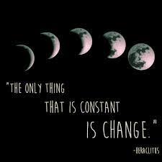
Change Nothing & Nothing Will Change – Life Begins At The End Of Comfort Zone
How To Come Out From Your Comfort Zone – How To Become Comfortable In Uncomfortable Situation?
Winners Never Quit V/S Winners Always Quit
Future Is Choice Of Today – Let’s Make Best Choice
How To Overcome Social Anxiety Disorder

Slide 23
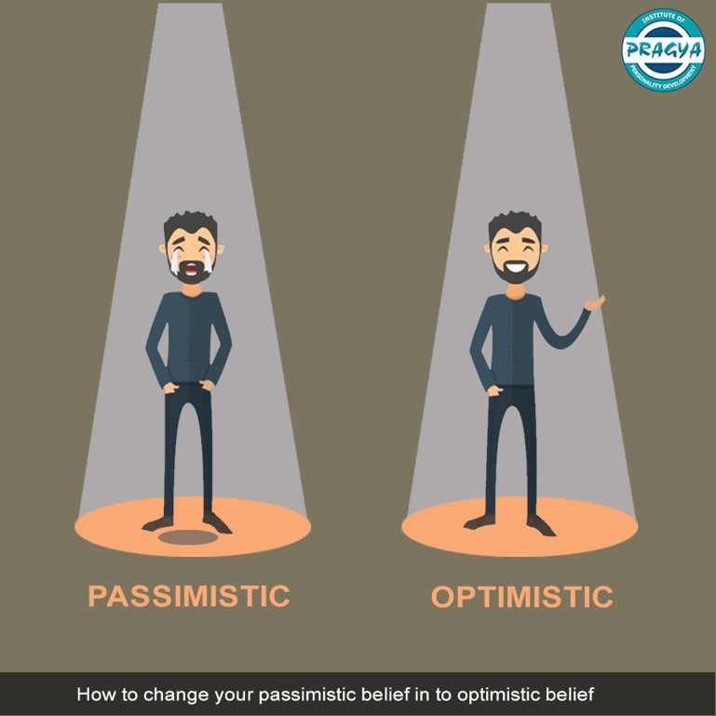
Endless Possibilities Exit Beyond Your Belief System : Power Of Belief System
How To Change Your Pessimistic Belief Into Optimistic Belief
Practical Aspect Of Law Of Attraction And How It Works, A Move From Illusion To Reality
Dream Big – Only Illusions Convert Into Reality
Power Of Belief System Is Extraordinary, It’s Life Changing

Slide 24
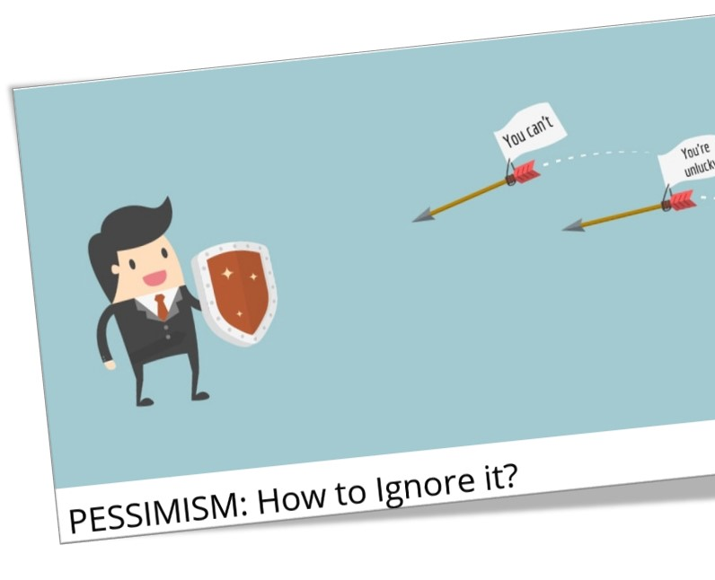
The Brain Is Wider Than The Sky : Programming Of Brain
How To Control Your Brain Or Programming Of Brain
Why Mother Is Always So Caring, Understand Through Programming Of Brain
Overcome From Class Room Life, Importance Of Soft Skill Training?
Know Why You Are Born, Is Really God Helping You?

Slide 25
A Negative Mind Will Never Give You Positive Life : Think Positive And Act Positive But How?
Positive Powerful Thinking Is A Key, How To Overcome From Negative Thoughts, Is Social Media Really A Major Culprit, How to Manage It?
Check Who Is Your Mental Travel Partner? It Has Lot Of Impact In Your Life
Only Positive Thinking Is Not Enough, What Else You Need?
Why Optimistic Not Realistic Is The Right Approach?

Slide 26
Knowing Yourself Is Beginning Of All Wisdom : Know Your Potential
Discover Your Potential - You Are Born To Become A Winner
Choose The Work That Suits Your Talent / Interest
Importance Of Self Talk
You Are Stronger Than You Think - Must Know About Yourself
A Glimpse Of Soft Skills And Hard Skills

Slide 27
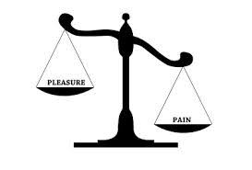
Best Way To Escape Your Problem Is To Solve Them : Problem Solving Skills
Problem Solving Skills, How To Solve Your Own Problems?
Best Approaches To Manage Worst Time Of Life, When You Don’t See Any Ray Of Hope
How To Develop And Why To Develop Constant Review Mechanism ? Manage Hedonic Adaptation
What Is The Best Time To Learn? It Is Extremely Important To Know
How To Keep Balance Between Pleasure And Pain?

Slide 28
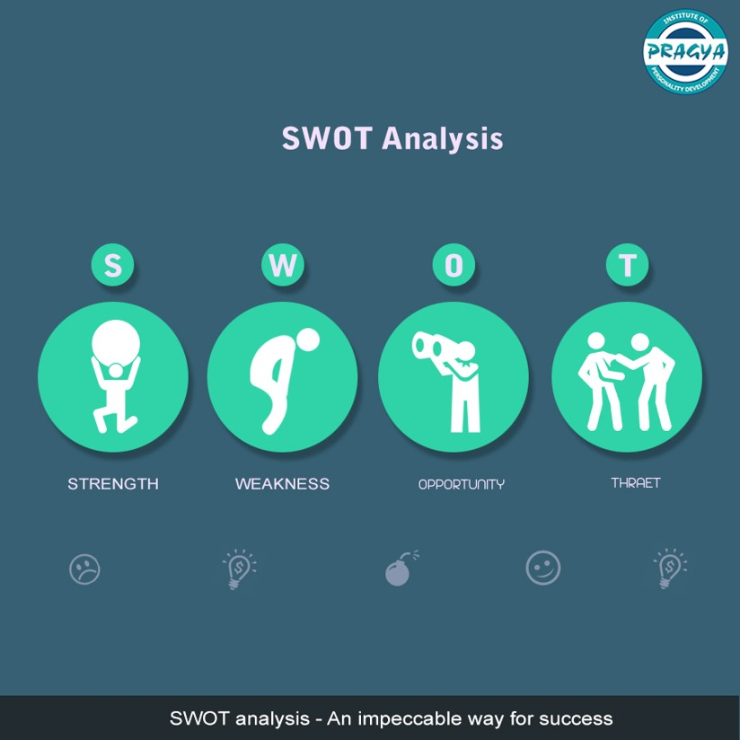
Setting Goals Is The First Step In Turning Invisible Into Visible : How To Set Goals?
SWOT Analysis - An Impeccable Way for Success
Goal Setting, How Set Goal of Your Life? People With Goals Succeed Because They Know Where They Are Going and Why They Are Going
How to Identify Opportunities in Life and Drive Best Result out of These Opportunities

Slide 29
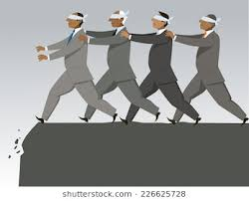
Don’t Be Part Of Crowd, Be A Reason For It : We Help You In Designing Your Life
Choose The Correct Location On Life’s GPS, If Not Selected Don’t Worry, Let’s Understand What To Do
Just Do Not Follow The Crowd, Design Your Own Path
Hear The Unheard

Slide 30
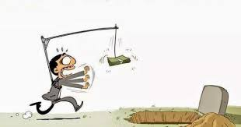
Kill Them With Success And Burry Them With A Smile : Pathway Of Success
Various Aspect, How To Look At Life?
Check - Have You Made The Right Choice Of Your Life?
Life Development Programme
Work For Cause, Not For Applause
Check - Are You Member Of Club Of 99?

Slide 31
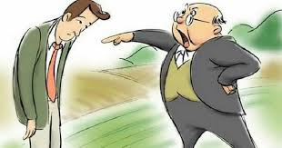
If You Can’t Be Wise, Hang Out With Wise People – Choose The Best And Do The Best, But How?
Don’t Expect The Good Things From Bad People
Be Cautious In Making Friends – They Have Huge Impact On Your Life, How To Do That?
Hidden Facts Behind Companies Logo – Develop Creative Thinking
How I Became Smilographer?

Slide 32
Work Without Passion Is Slavery : How To Convert Passion Into Profession?
Ignite Your Passion To Be A Winner
Ways To Find Out Your Passion
How To And Why To Follow Your Passion?
How To Convert Your Passion Into Profession?
Why People Feel Tired And Need Vacations?

Slide 33
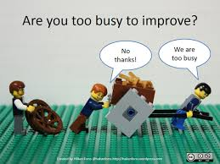
It’s Not The Load That Breaks You Down, It’s The Way You Carry It : Being Result Oriented Is The Key, But How?
Hard Work V/S Smart Work V/S Result Orientation
40+ Hours Rule To Become Millionaire Or Billionaire
Being Lazy Is Also Good, But How? At The Same Time, How To Overcome Laziness and Develop Enthusiasm?
How To Get Adequate Results Of Your Efforts?

Slide 34
It’s Going To Be Hard But Hard Doesn’t Mean Impossible : Develop Strong Will Power, But How?
Know What Is Your USP
How To Get Sustainable Result In Life?
Meaning Of Life And A Step Towards How To Live It? You Will Be Known For What You Have Done
How To Develop Strong Will Power?

Slide 35
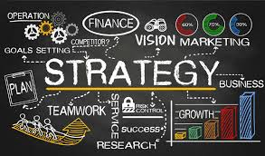
Vision Without Execution Is Hallucination : Be An Effective Planner And Fast In Execution With Excellence
Work On The Cause Not On The Symptoms, Craft Your Life With Effective Planning, Planning Plays A Vital Role In Your Success
Difference Between Planning And Strategy
Planning Is Good Or Bad?
What Is More Important? Effective Planning Or Fastest Excellence In Execution?
How To Build Yourself As A Good Product?

Slide 36
Failing To Plan Is Planning To Fail : Plan Your Execution and Execute Your Plan, But How?
Do More Information Leads To Confusion Or Clarification?
Power Of Delegation - Key Points Needs To Be Remembered Before Delegation
Optimal Utilization Of Resources – Biggest Management Lesson
Major Cause Of Failure In Life, How To Overcome From Such Challenges?

Slide 37
If Everything Seems Under Control, You Are Not Going Just Fast Enough : Be Fast Mover, Key Factor In 21st Century
A Perfect Guide On Effective Planning And Fastest Excellence In Execution
Idea Is Just A Seed, How To Nurture Your Seed And Make It A “Kalpvriksh”?
Be Fast Mover, But How?

Slide 38
It’s Not How Much Money You Make; How Much You Keep : Key Learnings For Happiness
Understanding Of Improvisation As Well Here And Now
Financial Planning For Financial Peace
Why Women Empowerment Is So Important And Best Ways To Do It
How To Overcome From Overthinking?

Slide 39
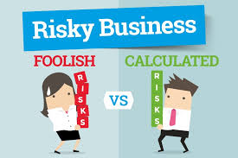
Not Taking Risk Is The Biggest Risk : How To Take Calculated Risk?
What Is Risk?
Take The RISK Or Loose The Chance, Develop Risk Taking Ability
Most Powerful Guidelines To Understand And Develop Risk Taking Ability
You Are The Salt Of The Earth And Light Of The World, You Are Unique, Live This Uniqueness

Slide 40
When You Know Better You Do Better : Power Of Universe
How Parents Make Their Kids Overweight?
Clear Or Smart Goals for life?

Slide 41
People Are Rewarded In Public For What They Practice For Years In Private : Journey Toward Perfection
What Makes Man Perfect? Perfect Practice But How?
Process Of Perfect Practice And How To Do It?
Why People Quit From Practice, How To Stay Tuned ?
How To Focus On Your Goals?

Slide 42
Practice Like You Have Never Won, Perform Like You Have Never Lost : Do It And Do It Now
Key Success Factor Of Japan, Kaizen
Law Of Paying The Price
There Are Four Type Of People, Check Who Are You?
Nothing To Prove, Everything To Improve

Slide 43
Patience Is Not About Waiting But The Ability To Keep Good Attitude While Waiting : Patience Is The Key, Let’s Understand Facts
If You Want Good Fruits, You Must Create Good Roots, Patience Is The Key To Success But Do You Really Know What Is Patience? Patience Is Not About Waiting
What Is 8th Wonder And How It Work?
Things Which Converts Your Weaknesses Into Strengths
Social Recognition Or Professional Recognition
What Taste Do You Leave In Others Mouth?

Slide 44
No Response Is A Response And It’s A Powerful One : Take Your Communication Skills To The Next Level
Unveil Secrets Of Effective Communicators, Do You Want To Become An Effective Communicator?
Why Communication Is Most Important Part Of Our Personality?
How To Convert Your Network Into Connection?
Relationship Building Skills, How To Build Strong And Long-term Relations?
Relationship IS Key To Success Not Networking

Slide 45
What Is Behind Your Eyes Hold More Power Than What Is In front Of Them : Perception Management
Necessity Is the Mother of Invention, Need Is More Important Than Want and It Leads to Results
How to Convert Argument into Discussion
Perception Management Skills and How to Build Perception?

Slide 46
Effective Communication is Bridge Between Confusion and Clarity – Be An Effective Communicator
Power Of Active Listening
Power Of Body Language
Power Of Smile
Power Of Observation Skills
Power Of Hand Shake
Power Of Eye Contact

Slide 47
When You Speak You Just Don’t Deliver Words, Convey Your Thoughts : Communication Is The Key To Success
Fake It Till You Make It – Powerful Tool For Effective Communication
Power Of Match The Mood
It’s Not Sympathy, It’s Empathy Which Works
Power Of Word Detective
Verbal Communication – Power Of Positive Words – Change The Words, Change The World

Slide 48
Communication Works For Those Who Work At It : Art Of Negotiation
What To Speak, When To Speak, How To Speak And How Much To Speak?
Avoid Waffle Words In Your Communication
Art Of Negotiation – Must Know That
Do's And Don'ts About Social Media Messaging
Phone Etiquettes - Power Of Phone Etiquettes - T-con And Web Conference

Slide 49
All The Great Speakers Were Bad Speakers At First : Improve Public Speaking
Public Speaking, Say No to Fear of Mike
Importance of Debate and Best Ways to Present Your Thoughts During Debate
How To Make Significant Impact During Group Discussion

Slide 50
Wearing The Correct Dress For Any Occasion Is A Matter Of Good Manners : Improve Your Dressing Sense
How To Start And Keep Conversation Going?
Questioning Is An Art, How To Become Expert In It?
Have A Dressing Sense but How? The One That Suits to Your Personality

Slide 51
You Don’t Have To Be Great To Start But You Have To Start To Be Great : Improve Your English Communication Skills
Best And Practical Methods To Improvise English Communication Skills.
Speaking Multiple Languages, Increase Power Of Brain, Let’s Understand

Slide 52
View Life As A Continuous Learning Experience : Observe, Absorb And Express Key Skill For A Winner
Power Of Imagination
Best Method Of Learning Is Observation, How To Increase Your Observation Skills?
Learn From Things Around You
Facts Beyond Science
It Is Always Great To Know People By Their Name, Know The Ways To Remember Name

Slide 53
We Can’t Drive People, We Must Teach And Lead : How To Give Negative Feedback Positively?
By Default Human Nature Is To Focus On Negative’s, Be Cautious
Good Intentions Behind Pointing Out Mistakes Is Never Harmful, How To Give Negative Feedback Positively?
Giving Feedback Is An Art, It Decides Whether You Will Go Upward Or Downward, Must Learn
We Are Brainwashed That People Are So Bad, Let’s Understand The Facts
How To Become Lovable?

Slide 54
A Moment Of Gratitude Makes A Difference In Your Attitude : Art Of Giving Feedback – Relationship Building
Honest Appreciation Is Biggest Motivation
World Looks How You Look At It, Change Your Vision, Is That So Easy? Yes, It Is
Quality Of Your Thoughts Become Quality Of Your Life
How To Improve Quality Of Your Life

Slide 55
Feedback Is Free Education To Excellence, Receive With Grace And Sincerity : How To Receive Feedback?
Things You Must Do After Someone Highlights Your Mistake, A Step Toward Success… Want To Grow In Life?
Get Comfortable With Being Uncomfortable
Life Is Not About How Good You Are, It’s All About How Good You Want To Be
How To Stop Taking Things Personally?

Slide 56
Don’t Say Maybe If You Want To Say No : How To Say Yes And No?
This Is How To Say "NO", Stop Suffering Now, Big Problem But Simple Solution Because Every Yes Is Also No
How To Say “YES” Do You Know Perfect Way?

Slide 57
It Takes A Habit To Replace A Habit : Develop Powerful Habits Of Winners
Power of Silence
Power of Affirmations
Power of Visualization

Slide 58
Laziness Is Nothing More Than The Habit Of Resting Before You Get Tired : Develop Powerful Habits Of Winners
Power Of Exercise
Power Of Reading And How To Increase Your Reading Speed
Power Of Scribe/ Writing

Slide 59
Every Closed Eye Is Not Sleeping And Every Open Eye Is Not Seeing : Important Tips On Daily Habits
Face Your Truth
Tips to Fall Sleep Quicker and To Take Sound Sleep
3*1/2 Minutes Rule Of The Night
How to Energize with The Rest of Few Minutes Only?

Slide 60
Discipline Is The Bridge Between Goals And Accomplishment : How To Become Disciplined?
Being Organized And Committed Is The True Definition Of Discipline
Easy But Effective Way To Follow Discipline In Your Life
Stop Saying Start Doing, Millimeters Makes Kilometers
How To Increase Your Credibility?

Slide 61
Don’t Focus On What You SEE, Focus On What You Want To Be : Unless You Stay Focused, Forget About Victory
In Current Scenario You Have Maximum Opportunities To Earn
Tips To Glue Your Eyes On Your Goals, Focus Is The Key, How To Stay Focused?
Be Driver Of Your Own Life Not Passenger

Slide 62
The Go Giver – A Curriculum for Making Difference : Important Message To Live A Better Life
Law Of Value
Law Of Compensation
Law Of Influence
Law Of Authenticity
Law Of Receptivity

Slide 63
Enjoy Life Now This Is Not Rehearsal : We Don’t Have A Great Day, We Make It A Great Day : How To Make Your Life Great?
Developing Sense Of Humor
Do, What You Want
How To Increase Your Concentration And Memory?
How To Control Your Sense Organs? A Brief And Useful Tool
Forgetfulness Is A Sign That You Are Intelligent

Slide 64
There Are Some Things That Money Can’t Buy Like Manners, Morals And Integrity : Develop Etiquette But How?
Dining Table, Party Etiquette
How To Organize A Party At Home?
Meet With Smartest People I Know

Slide 65
If You Take Responsibility For Yourself, You Will Develop A Hunger To Accomplish Your Dreams : Important Facts To Know – Key Factors
Mirror Concept Of Life And Don’t Die Before You Die
Aim High, Achieve More
What You Are Storing?
Reason Why We Can’t Print Unlimited Currency?

Slide 66
If Plan “A” Didn’t Work The Alphabet Has 25 More Letters : How To Manage Failure?
This Is It! You Need To Know How To Fight Back From Failure
Life Is Nothing But Choices You Make. Life Starts With B And Ends With D
Journey From Worrier To Warrior

Slide 67
Wear Your Failure As A Badge Of Honour : How To Overcome Fear Of Failure?
Own The Responsibility Of Your Life, Stop Blaming Others
How To Choose And Why To Choose A Mentor For Your Life?
Failure Is Part Of Success Not Opposite Of Success, Let’s Move On But How?
Art Of Failing Successfully

Slide 68
Never Stop Learning, Because Life Never Stop Teaching : Learner Is The Way to Become Good Earner
Intense Efforts
Intense Focus, How To Manage Distraction In Life
Alert Approach
Nature Is Biggest Teacher But How To Use It?
Leave Comfort Zone

Slide 69
The Roots Of Education Are Bitter But Fruits Are Sweet : How To Become Genius?
Learn From Life Of Universal Genius And Move Forward
People will Do What You Want, How to Influence Others Decision Making, Excellent Tips and Techniques
Tips to Score Outstanding and How to Be an Influential Personality?
How to Become A Good Teacher?
Are You Spiritual OR Religious?
Let’s Know Few Things You Can Never Compensate, What These things are?

Slide 70
To Be Angry Is To Punish Yourself For Other’s Mistake : How To Control Anger?
Make Your Anger Your Strength
Why We Get Angry? Psychology Or Science?
Let’s Understand How We Can Maintain Our Mental Peace?
Anger Is A Powerful Emotion, Use It Well
If Anger Is Out Of Your Control Flush It Out

Slide 71
When You Stop Expecting People To Be Perfect, You Like Them For Who They Are. Know How To Manage Expectation And Insult?
Law of Nature
Price of Love in Your Life
Most Selfish Word Is Expectation, Managing It Is Key To Happiness
Insult Is Good but How?

Slide 72
Go Where You Are Celebrated Not Where You’re Tolerated : How To Do That?
How to Handle Bullies?
How To Manage a Situation When Someone is Ignoring You?
How To Deal With Bipolar Disorder?

Slide 73
Control Your Emotions or Your Emotions Will Control You : Quotient Management – Very Important To Know
Emotional Quotient / Intelligence Quotient/ Quotient Of Love – Extremely Important to Understand in Current Scenario
Don’t Let Your Emotions Distract You From Doing What Needs To Be Done

Slide 74
Leave Your Ego, Otherwise Everyone Would Leave You : How To Control Ego And Manage Self Esteem?
Most Poisonous Word Is Ego, How To Manage Ego?
What Is The Difference In Self Esteem And Ego?
Art Of Living, You Don’t Have Ego And Your Self Esteem Is Also Not Compromised
Why We Need Money? Let’s Understand The Facts

Slide 75
Good To Forgive, Best To Forget : How To Control Ego?
Forgiveness And Gratitude, Accepting! Biggest Challenge | How To Admit Your Mistakes. Power Of Magical Words Will Change Your Life
Biggest Mistake Of Life, Never Do This
Power Of Forgiveness
Law Of Gratitude
Art Of Admitting Your Mistakes
How To Overcome Guilt

Slide 76
The True Measure Of Character Is What You Do When Nobody Is Watching : Honesty Is Wisdom
Is Honesty The Best Policy Even In Today's World?
Trying To Cheat Others? Find How You Are Cheating Yourself
Loyalty Is The Key, Know How?
Professional Honesty Is Key To Long Term Growth
Cheating Is Choice Not A Mistake

Slide 77
Respect Those Who Deserve It Not Those Who Demand It : Know How To Earn Respect?
How To Overcome Trust Issues In Relationship
What Is Respect? You Should Know, Everyone Wants It But Only You Can Earn It?
Is It Fear Of The Authority Or Respect Of The Authority
Trust But Verify

Slide 78
No One Is Going To Save You, This Is 100% Your Responsibility : How To Become Cool And Smart Personality?
Branded V/S Generic Medicine: Truth Behind It, Important To Know For Your Health
Swadeshi Or Videshi, How To Look At It?
Meaning Of Cool And Smart Personality, Do You Also Want To Be?

Slide 79
Creativity Is A Wild Mind And Disciplined Eyes : Be Creative And Overcome Fear But How?
Are You Creative? Understand Creativity As Per Current Scenario, How You Can Become More Creative?
Never Let The Fear Hover Over Your Head, Let’s Understand Psychological And Physical Fear
Perfection Also Cause Fear, How To Overcome It?
Live Before You Die, Don’t Die Before You Die
Power Of Courage
Limit The Use Of Search Engine, It Kills Creativity

Slide 80
Fear Kills More Dreams Than Failure Ever Will : Important Tips To Overcome Fear
Understand Difference Between Love And Attachment
Desire Is Key Of Success, Desire Also Increases Fear, How To Manage It?
Tradition And Morality Are Always Not Same

Slide 81
The True Entrepreneur Is Doer, Not A Dreamer : How To Become A Good Entrepreneur?
Which Way to Go? Entrepreneur or Private Job or Government Job? How and Why?
Make A Choice and Know How to Become Good in It
Qualities of An Entrepreneur, Power of Entrepreneurship

Slide 82
If You Don’t Build Your Dreams Someone Else Will Hire You To Fulfill Their Dreams : Private Job/ Government Job/ Entrepreneurship – Let’s Make A Choice
Blind Run Behind The Government Job Is Really Depraved, Eye Opening Facts
Be Selfish!
Guidelines For Startup, How To Ask For Help?
Law Of Sharing And Caring

Slide 83
We Can’t Teach Everything To Anybody, We Can Make Them Think : Develop And Improve Critical Thinking
Bid Adieu To Confusion To Welcome Clarity, Gauge Your Analytical Skills To Make Sound Decisions And Improve Performance
Analysis May Lead To Paralysis, To Know How And How Much Is Very Important
How To Increase Logical Brain?
Open Your Brain And Look At The Facts, Start Looking At The Things With Different Dimension

Slide 84
The Right Decision Is The Wrong Decision If It’s Made Too Late : Develop Strong And Rapid Decision Making
Stop Watching, Go For Action Now
How To Make Strong Decisions Rapidly? Quick View
Improve Your Productivity With 80/20 Rule
How To Take Tough Decision In Tough Situation

Slide 85
Today I Will Do What Others Won’t So Tomorrow I Can Do What Others Can’t : Take Initiative But How?
How to Choose Your Life Partner?
Taking Initiative Is A Key Quality Of A Leader, Let’s Make A Start
5 Monkeys Experiment

Slide 86
An Expert In Anything Was Once A Beginner : Tips Of New Era
How To Write An Email Professionally? Simple But Most Effective Guide
How To Protect Yourself From Radiation?
How To Get Out Of A Bad Mood?
Key To Long Lasting Social Media Impression
How To Be Perfect At Virtual World?

Slide 87
You Don’t Get The Same Moment Twice In Life : How To Become A Celebrity?
Follow The Guidelines, Your Life Will Be Changed In A Year, Know How?
Do You Want To Become A Celebrity?
Nobody Can Help Everybody, But Everybody Can Help Somebody

Slide 88
Success Occurs When Opportunity Meets Preparation : How To Conduct Successful Meetings & Data Security?
How To Conduct Meeting? Personal Or Social Or Professional? Need Some Exemplary Skills
Was That Okay Concept?
Data Security, Need Of Internet World
How To Reduce Addiction Toward Social Media?

Slide 89
Sales Is Not About Selling Anymore, It’s About Building Trust And Educating : Life Is Nothing But Sales And Marketing
Life Is Nothing But Sales And Marketing, Success Of Personal, Professional And Social Life Depends Upon Your Marketing And Selling Skills
How To Influence Or Convince People?
Understanding Of Consumer Behaviour

Slide 90
If You Don’t Take Care Of Your Customers, Competitor Will : Different People Approach Differently
Understanding Of Adoption Ladder
Assertive Or Aggressive? There Is Thin Line. What To Use, How To Use, When To Use?
Understanding Of Different Behaviour Style, How To Use In Day To Day Life And Market?
Everyone Is Different, How To Approach?

Slide 91
Be The Type Of The Person You Want To Meet : Life Is Nothing But Sales And Marketing – Let’s Know About Extraordinary Selling And Marketing Skills
Understanding Of Product Life Cycle, Understand From Current Era Perspective
Importance Of Market Intelligence And How To Improve
7 P’s Of Marketing Mix
Customer Centric Interaction. Tailor Made Behaviour With Each Individual To Be Highly Influential In Life

Slide 92
My Life Is Constantly Under Construction. There Is Always Something To Improve : Improve Yourself As Per The Need Of 21st Century
Illiterate of 21st Century Is One Who Is Not Ready to Learn, Unlearn and Relearn – Need of VUCA World
How to Create A Business Model?
No Product Is Costly Or Economic, What Is and How A Customer Takes His Decision?
Do You Have Problem Solving Product?

Slide 93
If You Don’t Have Competitive Advantage Don’t Compete : Let’s Know - Success Mantra In Such A Competitive Environment
Employee Retention Formula Of 21st Century
Unbiased Approach Is Key To Growth
BCG Matrix To Choose The Best Option, Understand When And How?
Football Center Of Attraction Formula
How To Maintain Professional Relationship?

Slide 94
Excellence Is Not A Skill, It’s An Attitude : Talent/ Attitude/ Skill/ Score Education/ Experience – What Is More Important?
Talent Or Attitude - What You Require For Success?
Five Life Changing And Important Facts From The Speech Of Honorable Mr. Ratan Tata
What Is More Important - Skill Or Score?
What Makes More Difference In Your Life - Education Or Experience?

Slide 95
To Be The Best, You Must Be Able To Handle The Worst : How To Develop Positive Attitude?
Your Attitude Decides Your Destiny
Fight Against Destiny And Win
Arrogance V/s Attitude, Same Or Different? How They Impact Your Life?
Need And Greed – How To Manage?
If A Person Says, “I Can’t Do This”, It Has Two Meanings
Will Is Far More Powerful Than Skill

Slide 96
Live With No Regrets, Love Without Limits : Live Your Life, Don’t Have Regrets When Dying
Live Your Life To The Fullest, Don’t Have Any Regrets, How?
What Will You Speak To Yourself While Dying?
What You Remember In Your Life? Let’s Understand Through Wonderful Thoughts

Slide 97
Nobody Can Make You Feel Inferior Without Your Consent : Gain Confidence Away From Overconfidence – Stay Motivated
Things You Should Never Stop Doing In Your Life, Must Know
Why Motivational Speech Have Short-term Impact? How To Be Always Motivated?
This Is Awesome! How To Gain Confidence And Stay Away From Overconfidence?

Slide 98
If You Really Want To Do Something, You Will Find A Way. If You Don’t You Will Find An Excuse : Power Of Inspiration & Motivation, Stop Giving Excuses – How To Keep Yourself Motivated?
We Understand The Incredible Power Of Inspiration And Motivation
Two Type Of Motivation And How They Work In Life
What Is Self-respect?
Pave Way To Success By Saying No To Excuses, If You Born Poor That’s Not Your Mistake But If You Die That’s Your Mistake

Slide 99
Life Is An Adventure, It’s Not A Package Tour : Best Success and Life Skill Mantra
Connecting The Dots Theory – Connection Between Past, Present And Future
Live Your Day As It Is Last Day Of Your Life
Stay Hungry Stay Foolish

Slide 100
Our History Isn’t Our Destiny : Write Your Own Destiny
Major Difference Between Successful And Unseccessful People
Hold The Pen To Write Your Own Destiny But How?
What Is Good Luck Or Bad Luck? Can You Change Your Destiny?

Slide 101
If We Can Manage Time, We Can Manage Anything Else : Time Management Is Life Management
A Guide to Manage the Time | Know How to Manage the Time
Tricks to Manage your Time Effectively
Procrastination Is Killer, How to Kill Procrastination?
Work life balance

Slide 102
Time Isn’t The Main Things, It’s The Only Things : Time Management
How To Manage Your Day And Calendar?
Impact Of Poor Time Management In Our Life
Gossip Is Major Time Killer With Its Toxic Effects, It’s Time To Say Good Bye
Are You In Monkey Business? Check Your Steps Before It’s Too Late
Habits Of Highly Productive People

Slide 103
Most People Don’t Listen With The Intent To Understand; They Listen With The Intent To Reply : Conflict Management
Conflicts Are Part Of Life, How To Manage Them? Understand Art Of Life
Sometimes Conflicts Are Good
Let’s Have A Look And Unfold The Strategies For Conflict Management, Understand Through Various Practical Situations
Competition Is Good But With Whom?

Slide 104
Expect More From Yourself And Less From Others : Love Is Key, It Opens Many Locks
Put Yourself In Others Shoe, Look At The World With New And Open Minded Perspective
Love Is Key To Success
Step Toward Real Success

Slide 105
It Takes Both Side To Build A Bridge : Managing & Building Relationship
How To Overcome Toxic Relationship And Build Strong Relation?
How To Manage Domestic Fights?
How To Get Over A Breakup?

Slide 106
When You Have A Strong Purpose, Then Hard Work Isn’t An Option, It’s Necessity : Life Is Art, Science And Commerce Of Living
Life Is Art Or Science Or Commerce Of Living?
Power Of Unconditional Love
Success Is Not A Shortcut, It’s A Process
Most Burning Word Is Jealousy, How To Maintain A Distance From It?
Most Powerful Word Is Knowledge, Acquire It

Slide 107
You Are Given This Life Because You Are Strong Enough To Live It : How To Become Ethically Rich And Mentally Tough?
How To Improove Standard Of Living?
Important Tips To Become Ethically Rich
Golden Rules Of Life - Never Taught In School
Overcoming Shyness From Opposite Sex
Being Mentally Tough Is Sign Of Iron In You, Signs Of Mentally Tough People

Slide 108
The Greatest Weapon Against Stress Is Our Ability To Choose One Thought Over Another : How To Live Stress Free Life?
Don't Let The Stress Hamper Your Enjoyment/ Productivity In Life
Stress Is Nothing But Inability To Manage, Do You Really Want To Manage?
Stress Management – Practical And Best Approach
Control The Controllable – Serenity Prayer
Present Is More Powerful Than Anything Else

Slide 109
Recovery Is Not For People Who Need It, It’s For People Who Want It : Quit Addictions and Unhealthy Food
Say NO! To Unhealthy Food Now
How To Quit Addictions?

Slide 110
The Purpose Of Our Lives Is To Be Happy : How to Live Happy?
How To Increase Acceptance And Reduce Expectations?
Don’t Worry About The People, What They Will Say, You Can’t Keep Everyone Happy
Either/ Or Will Cause Trouble For You
Understand The Difference Between Pleasure And Happiness

Slide 111
If You Are Born Poor, It’s Not Your Mistake But If You Die Poor That’s Your Mistake : Achieve What You Want
What Is Success? How We Should Live Our Life?
Winners Are Not Those Who Get The Best In Everything, But Winners Are Those Who “Make Best" Of Whatever That They Get

Slide 112
I Can’t But We Can : How To Build A Strong And Champion Team?
Instill Team Spirit With Unique Ideas, How To Build A Champion Team Rather Team Of Champions?
Most Satisfying Two Letter Word Is We
Miracles Can Happen If Experience And Energy Merged Together
People Are Assets Or Liability, Keep Your Concept Clear

Slide 113
Coming Together Is A Beginning, Staying Together Is Process, Working Together Is Progress : Formation Of Unbeatable Team
Understand Biggest Responsibility Of Team Members
When You Are Not Suppose To Help Team Member? How Much To Nourish Team?
Ubuntu Is The Way To Make A Strong Team

Slide 114
Be So Good They Can’t Ignore You : Prepare for Interview, Tips and Techniques Ensure Success.
C V Writing
It’s Just Not About The Numbers Of Years Of Experience You Have, It’s All About Quality Of Year Of Experience You Have
Important Things To Remember Before Interview
Important Things To Remember During Interview
Tips Regarding Attire

Slide 115
Stop Believing In Luck, Start Believing In Yourself : Know Hidden Facts About Interview Preparation
Preparation On How To Answer In Life
Do You Really Know When To Change Job!
When To Retire, One Must Know And What Is True Meaning Of Retirement
How To Take Interview? For An Employer And Employee, It Is Very Crucial To Know
Mock Interviews

Slide 116
Leaders Don’t Create Followers, They Create More Leaders : Complete Guide to Become a Remarkable Leader
There Is Huge Difference In Politics And Leadership
How To Become A Great Leader? Know The Qualities Of Great Leaders
Leadership Is Not About The Size, It’s About Knowledge And Wisdom
Good Culture Push The Wrong People Out

Slide 117
Leadership Is The Capacity To Translate Vision Into Reality : How To Become Incredible Leader?
What is Better - Good Leader Or Good Boss Or Both?
As A Leader You Have to Be Unkind to Be Kind
How to Become a Good Coach?

Slide 118
The Hands That Help Are Holier Than The Lips That Pray : Be Handsome
How to Become Handsome?
Law of Breathing
Learn, Earn and Return

Slide 119
I Will Win Not Immediately But Definitely : Write Your Own Destiny
Law Of Karma
What To Do? When It’s Not Your Mistake And Bad Things Are Happening To You
Want To Know What Is Biggest Success And How To Achieve It?
Let’s Understand How To Write Your Own Destiny?
Finally, What Is Win And How To Win?

Slide 120
Just Text And Images Cannot Define Us We Are Beyond Your Imagination

Slide 121
Praise Makes You Feel Good, Feedback Makes You Better We Welcome Your Feedback And Suggestion

Slide 122
Contact Us :
LinkedIn - http://lnnk.in/kKe
Facebook - http://lnnk.in/kMe
F.B – Page - http://lnnk.in/kOe
F.B – Group - http://lnnk.in/kQe
Twitter - http://lnnk.in/kSe
Instagram - http://lnnk.in/kUe
YouTube - http://lnnk.in/kWe
Skype - http://lnnk.in/kYe
Google - http://lnnk.in/k0e
Google+ - http://lnnk.in/k2e
Call – 7073188666
Whatsapp – 9829178749
Email – saupra2001@gmail.com
saurabh@pipd.in
info@pragyapersonalitydevelopment.com
Website – www.pragyapersonalitydevelopment.com
Walk In - Siddhant Complex, FS-2, Street No. 6, Adarsh Bazar, Barkat Nagar, Jaipur, Rajasthan 302015

